Slide 1
2018 3rd Annual Motivational & Education Days
Sherwood Parkdale Skating Club

Slide 2
Welcome Mary Liz Wiley
“Coaching skating is a privilege. It is an opportunity to inspire and BE inspired – to teach and Be taught, to challenge and BE challenged, to amuse and BE amused, to reach and to reach even higher….make a difference!” – Mary Liz Wiley

Slide 3
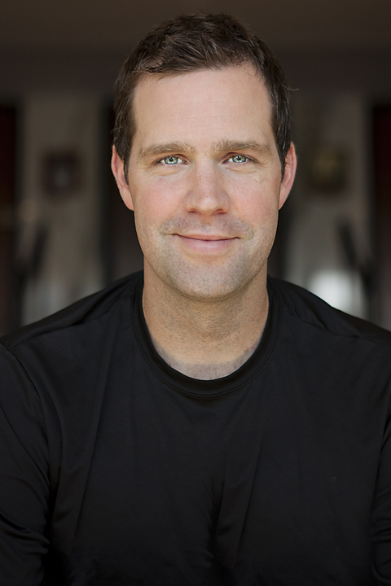
Welcome Kris MacPhee Master of Sport Science with a Coaching Major from the US Sports Academy BA-UPEI Certified Functional Strength Coach Certified Personal Trainer- CanFitPro Certified Sports Conditioning Specialist- IFPA (International Fitness Professional Association)
Off Ice Fitness Assessor

Slide 4
Jumpstart STARskaters
Fast Track for Figure Skating
All group lesson format
Private lessons may be requested
NEW - One session is with Advanced Canskate where Canskate badges are completed
NEW - Special Events with all STARskaters
NEW - *Eligible for Synchro Team

Slide 5
Junior STARskaters
Skaters are promoted to Juniors on the recommendation of Club Coaches and have completed Stage 6 of Canskate
Over 50% of skating times are in Group Format
Private lessons are encouraged though not mandatory
Assessments are provided by Group Coach and/or Private lesson Coach
NEW - Special Events with all STARskaters
NEW - *Eligible for Synchro Team

Slide 6
Senior STARskaters
Must have passed the complete STAR 2 Level and/or on recommendation of a Club Coach
NEW – 50% Group Lesson time scheduled
*skaters may opt out of jump/spin group lessons and practice independently
Private Lessons are strongly encouraged and may take place during group time
Skaters must secure a private coach for assessments & creation of solos
NEW – special events monthly “STAR Days”

Slide 7
Synchronized Skating returns to SPSC NEW – Full Synchro Team Programming
FREE for first two sessions
All STARskaters under the age of 15 as of July 1st are encouraged to attend
BENEFITS
Added ice time for over all development
Improve over all skating skills
Team environment

Slide 8
NEW - Holiday Ice Gala
Our Annual Ice Gala will take place in December this year
We will alternate between December and March in future seasons
Admission at the door will be for the food bank
We will accept food donations or cash donations
All treat sales on day of show will also go to the food bank
To offset out costs the club will keep
$5 registration fee
50% of advertising secure for our program brochure; remaining 50% goes as a credit on the participants account towards future registrations.
This Photo by Unknown Author is licensed under CC BY-NC-ND

Slide 9
What are your goals and expectations?
Short term
Long term
Being prepared for the unexpected
How best to prepare to leave the roadway open for a choice in paths…
How to achieve the best experience no matter your goals

Slide 10
Plan, Skate, Track

Slide 11
STAR 1-5 STAR 6 – Gold Assessments

Slide 12
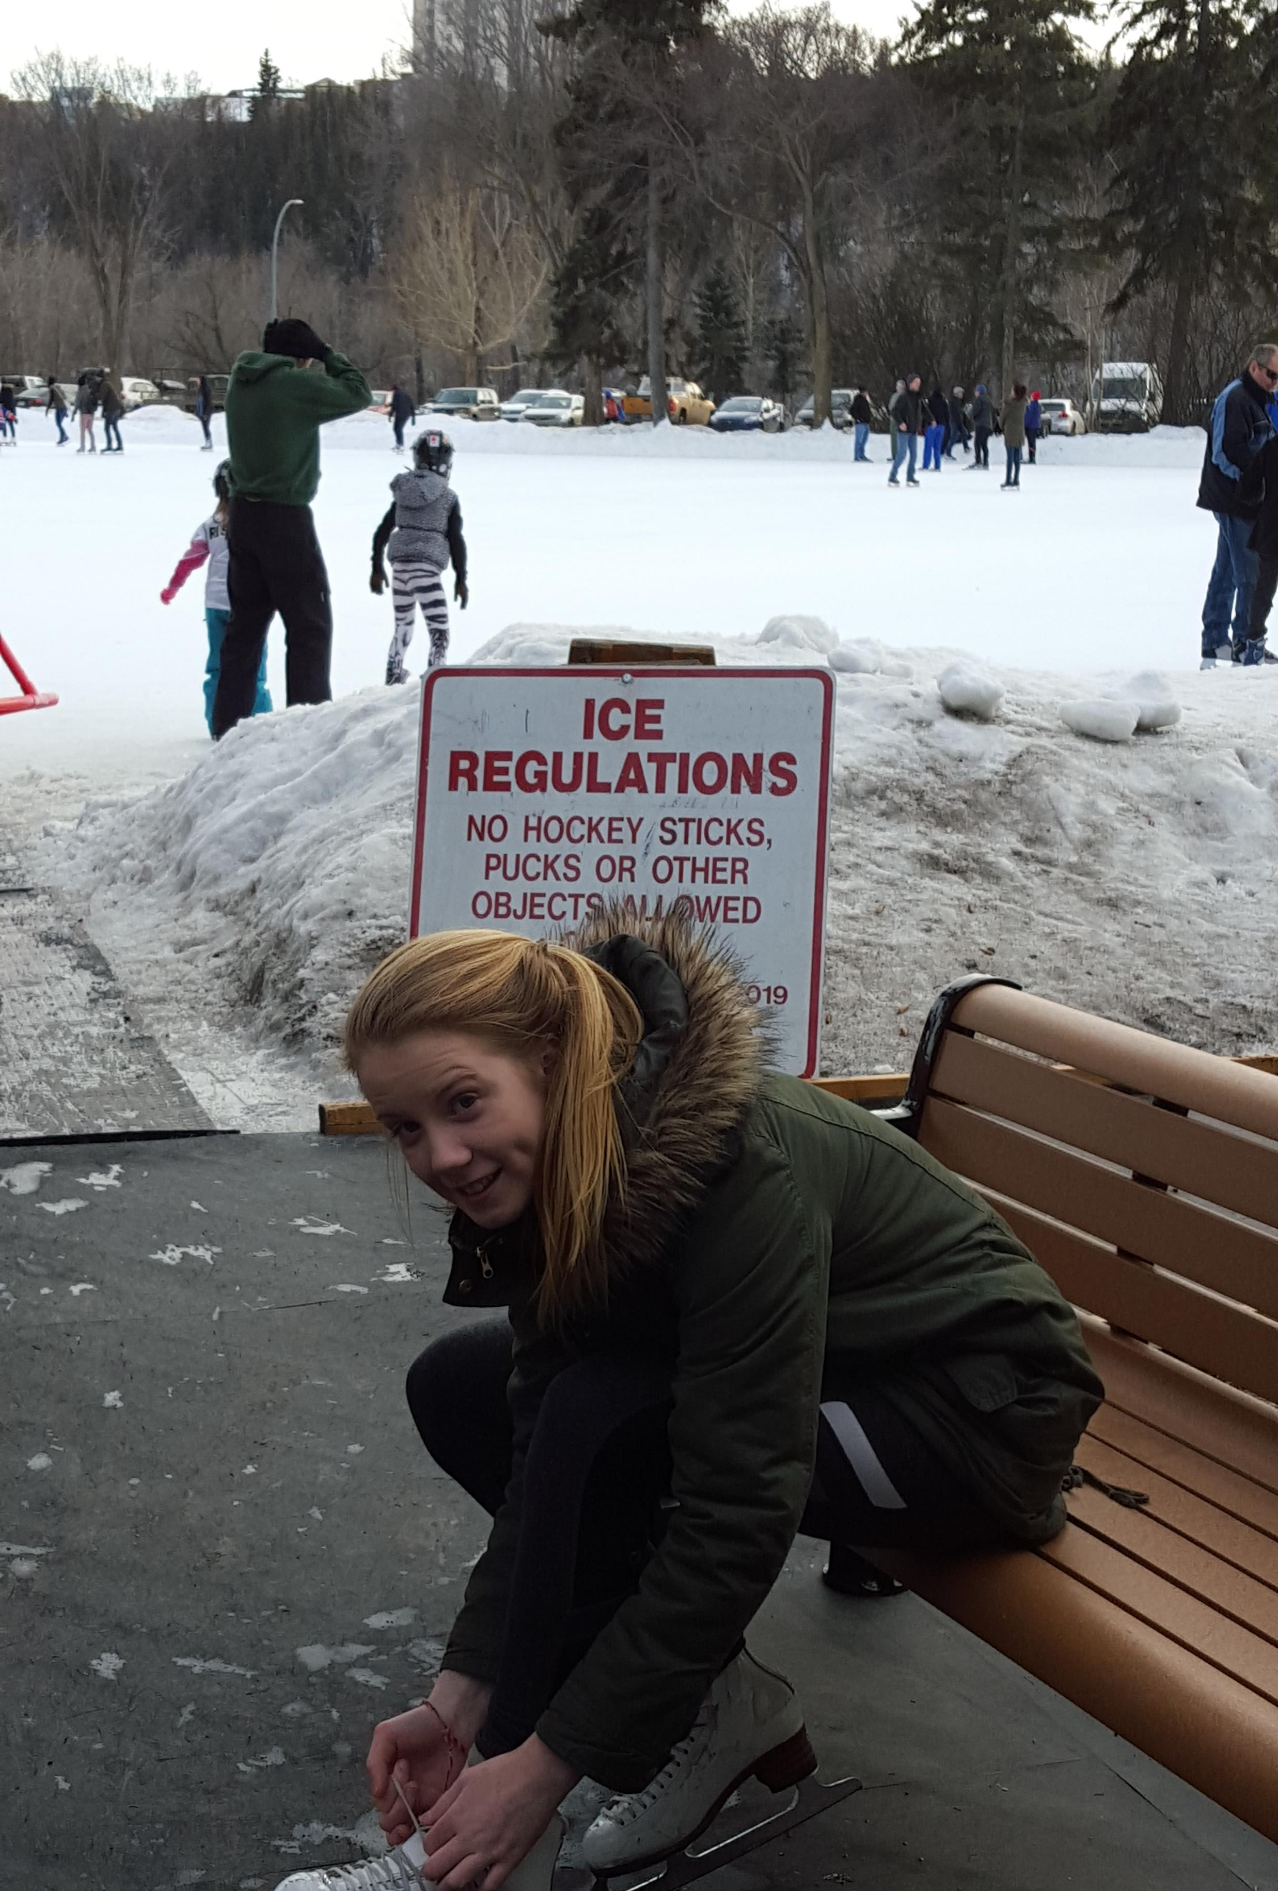
Keep it Fun!
The focus of STAR 1-5 should be on enjoyment and developing figure skating specific skills. Encourage skaters to have fun, try their best, and learn to find joy in all aspects of the sport. Remember this is their sport.

Slide 13
Focus on personal progress and effort.
Provide Emotional Support
Model Healthy Eating and Physical Activity

Slide 14
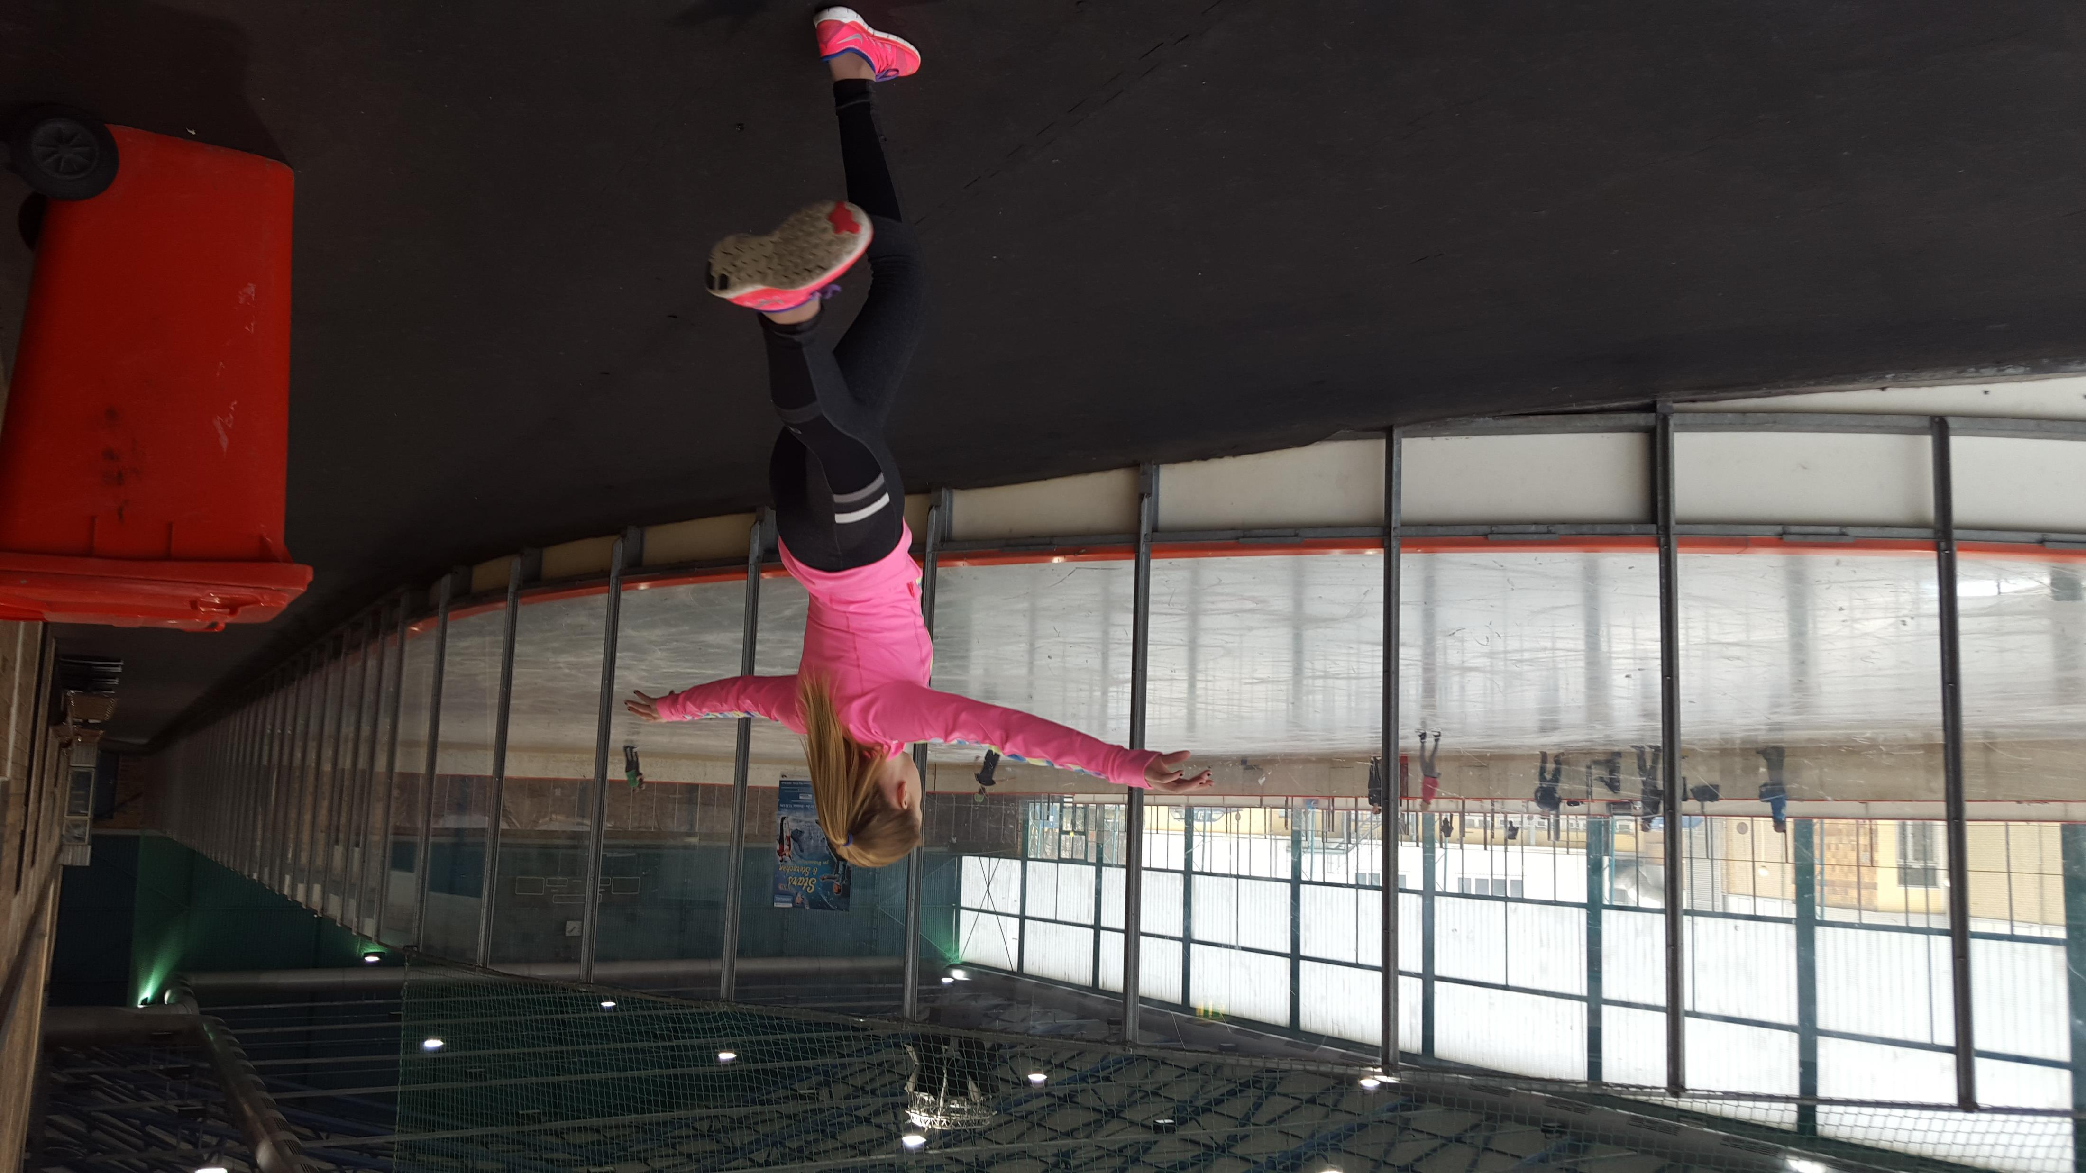
Competitive Skating
What is the difference between “Competitive & Competing”
Knowing the paths your skater can take and how to leave the roadway open

Slide 15
Competitive Age & Test Requirements
STAR5….
Pre-Juvenile U12 or U14 (some Provinces U11 or U13)
Juvenile U12 or U14
Pre-Novice U16
Gold….
Novice U17
Junior U19
Senior (no age limit)

Slide 16
STARskate
Jr ADL STARskate Championships
STAR 1 - 3
STARskate Championships
STAR 4 - Gold

Slide 17
Club Designated Events for 2018-2019
Club will pay the expensed of our club coaches to attend designated competitions with your skaters
Approved for the 2018-2019 Season
One off-island event: 2018 NB Winter Skate
2019 Jr ADL STARskate Championships
2019 STARskate Championships
Skaters using non-club coaches may submit their bills for consideration of reimbursement for reasonable expenses

Slide 18
Ask Questions
Don’t be afraid to ask questions about the way the skating world works! Your coach is a good place to start as are experienced parents and club volunteers. You can also find excellent information on-line at info.skatecanada.ca as well as your section and club websites.
The above link is also available through our Sherwood Parkdale Skating Club website.

Slide 19
Communicate with your Coach
Your coach is there to help you as well as your child. Communicate with them regularly about the progress of your skater and to chart a course for development that works for your family and your budget.

Slide 21
How to access your test records

